Slide 1
Unclogging Aggregate Bins
5.26.24 version 1.0

Slide 2
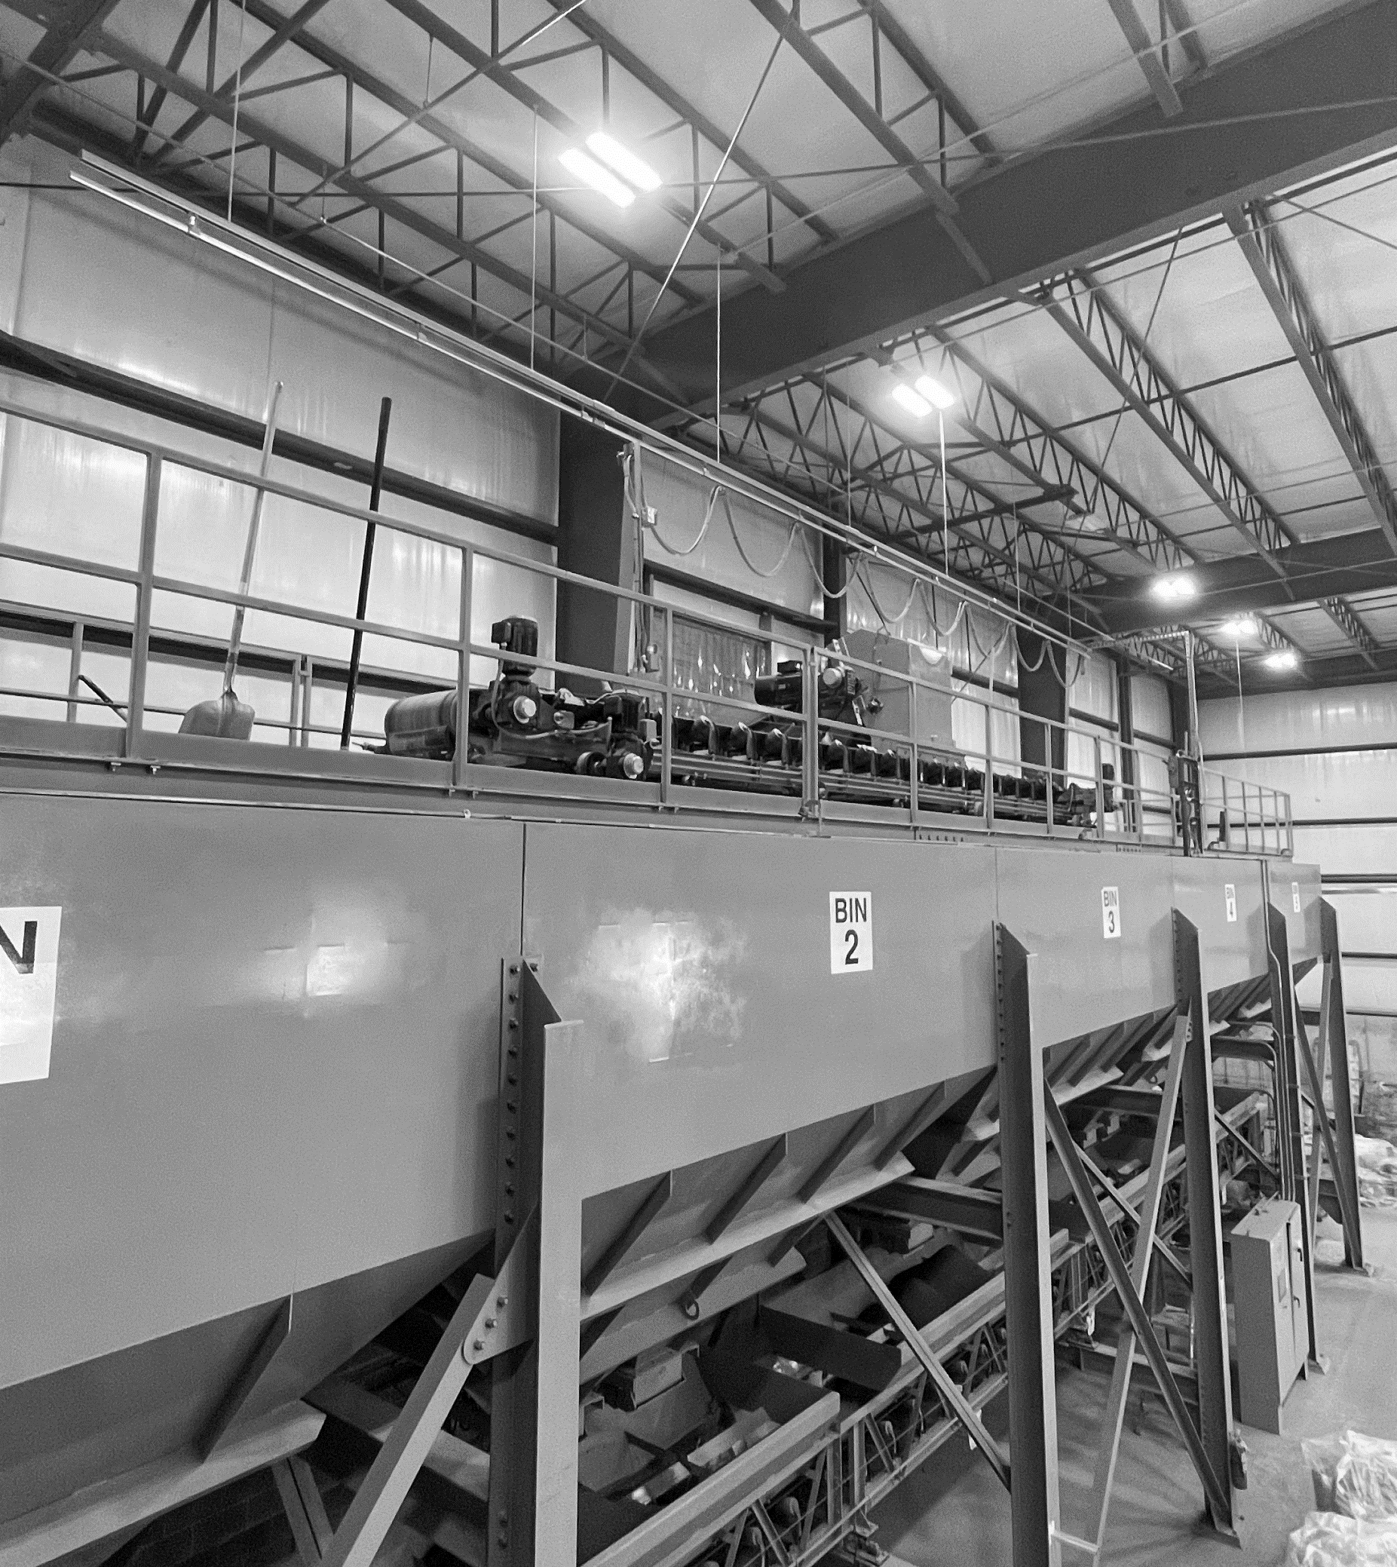
Assumptions and Prerequisite Skills
The computer is on and IntelliBatch 3.0 is open
Supplies Needed
Standard PPE
Air hose with chisel extension (possibly)

Slide 3
Before you begin checking for a clogged bin, make sure to visually confirm the bin is not empty. You can tell this by monitoring the vertical blue line next to each bin (Red circle in Figure 1). If the bottom light on the right of a bin lights up, this means that the bin is almost, if not completely, empty.

Slide 4
Procedure
Three signs that a bin is clogged:
A bin is at a stagnant green and the valve icon (Figure 2) remains at a vertical position for an extended period of time
When a valve is flickering back and forth for an extended period of time and the Aggregate Weigh Belt value is not increasing
You get an error message at the bottom of the screen (Figure 3)
Figure 2
Figure 3

Slide 5
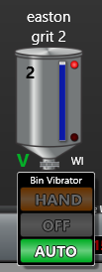
Procedure
If conditions (a and b) or (c) has been met, click on the V icon underneath the corresponding bin (Figure 4).
Click the “hand” button and wait for any change to the Aggregate Weigh Belt. The “hand" button vibrates the bin to remove any stuck aggregate that may be stuck at the bottom or sides (see purple circle in Figure 4).
Figure 4

Slide 6
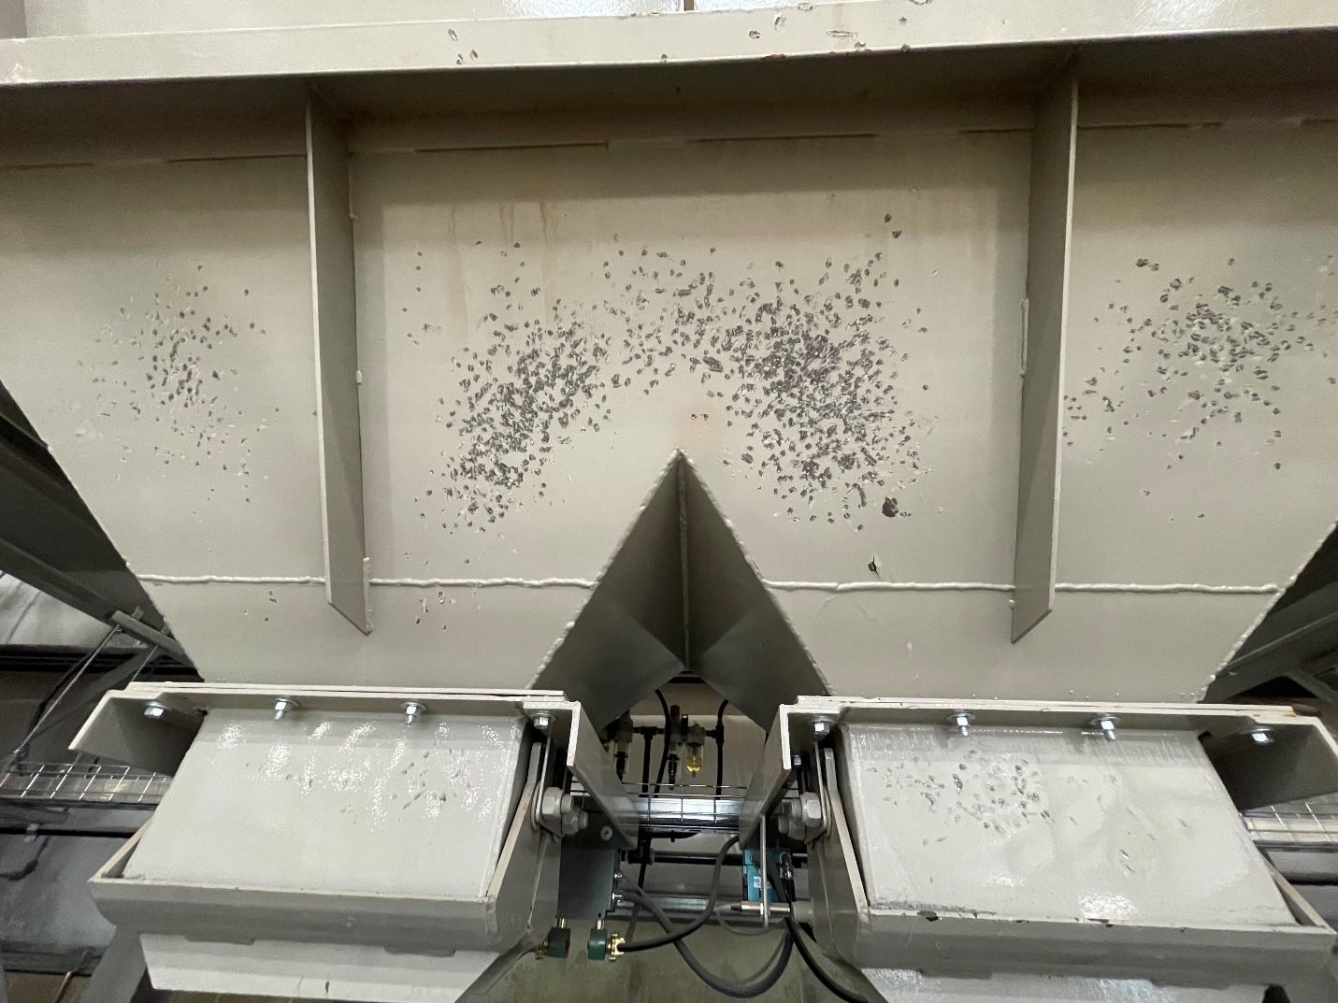
Procedure
5. Set up a ladder and repeatedly strike both sides of the bin in the yellow shaded area with a sledgehammer until the aggregate starts dropping at a steady pace (Figure 5).
Figure 5

